Slide 1

TRAVELIX(Resort Booking Website)
Ishita Ray Keerthana N P 1BM20CS061 1BM20CS071
Dr. LATHA N R
Assistant Professor
Department of Computer Science & Engineering
BMS College of Engineering
Notes:
1
*

Slide 2
Outline
Introduction
ER Diagram
Schema Diagram
Normalization
Software requirements/ Tools and technologies used
User Interface
References
Travelix Department of CSE, BMSCE 2021-22
2
Notes:
2
*

Slide 3
Introduction
“Travelix” is a resort booking portal.
Our website provides an interface to allow users to book a comfortable stay in a destination of their choice.
To ensure a hassle-free experience, the users are provided with a ride so that they can reach their resort easily.
Along with a hotel room, our website enables users to book activities at their respective resorts to have an enjoyable stay.
Travelix Department of CSE, BMSCE 2021-22
3

Slide 4
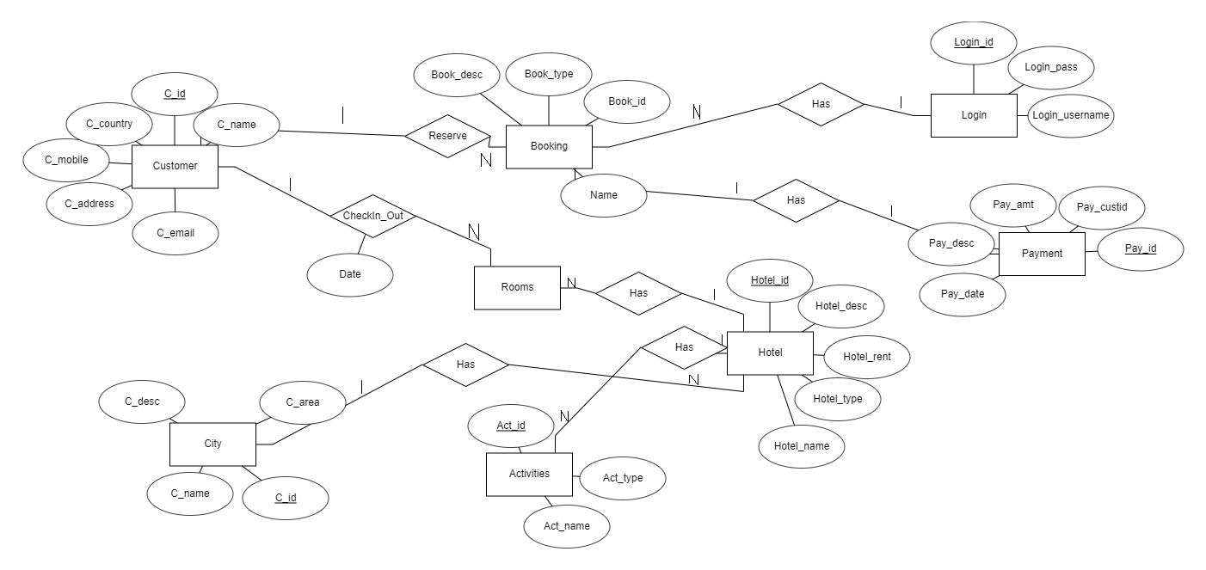
ER Diagram
Travelix Department of CSE, BMSCE 2021-22
4

Slide 5
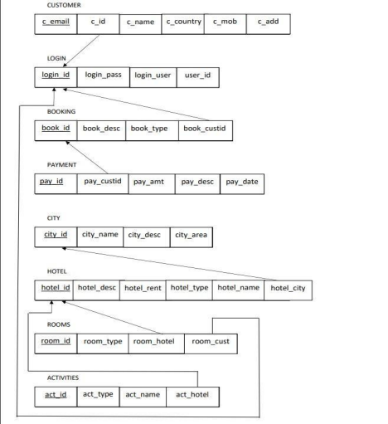
Schema Diagram
Travelix Department of CSE, BMSCE 2021-22
5

Slide 6
Normalization
Customer table - Contains the basic details of the customer such as his name, email, etc.
Login table - Contains the details of the user that is currently logged in to the website.
Booking table - Contains all the details of a booking request made by the customer.
City table - Contains details of the city in which the booking has been made.
Hotel table - Contains details of the hotel where the booking has been made.
Travelix Department of CSE, BMSCE 2021-22

Slide 7
Normalization
Room table - Contains details of the room that has been booked.
Activity table - Contains details of all the activities booked by the user.
Payment table - Contains information about the payments made by the customer.
Travelix Department of CSE, BMSCE 2021-22

Slide 8
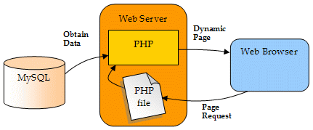

Software requirements
Travelix Department of CSE, BMSCE 2021-22
8

Slide 9

User Interface
Travelix Department of CSE, BMSCE 2021-22
9

Slide 10
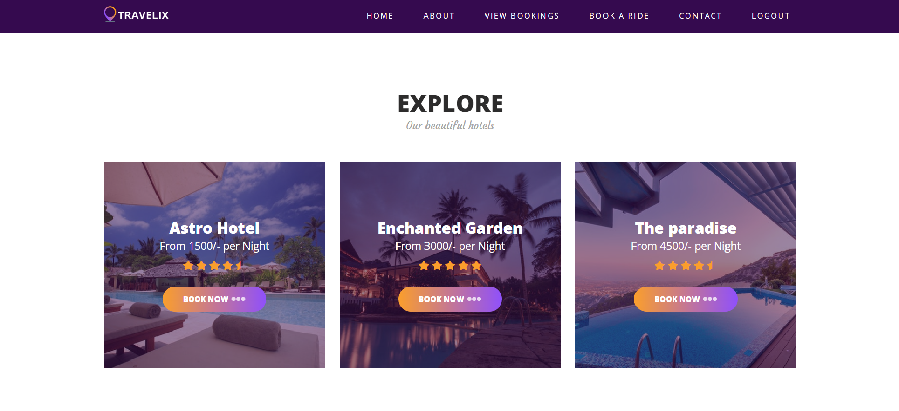
User Interface
Travelix Department of CSE, BMSCE 2021-22
10

Slide 11
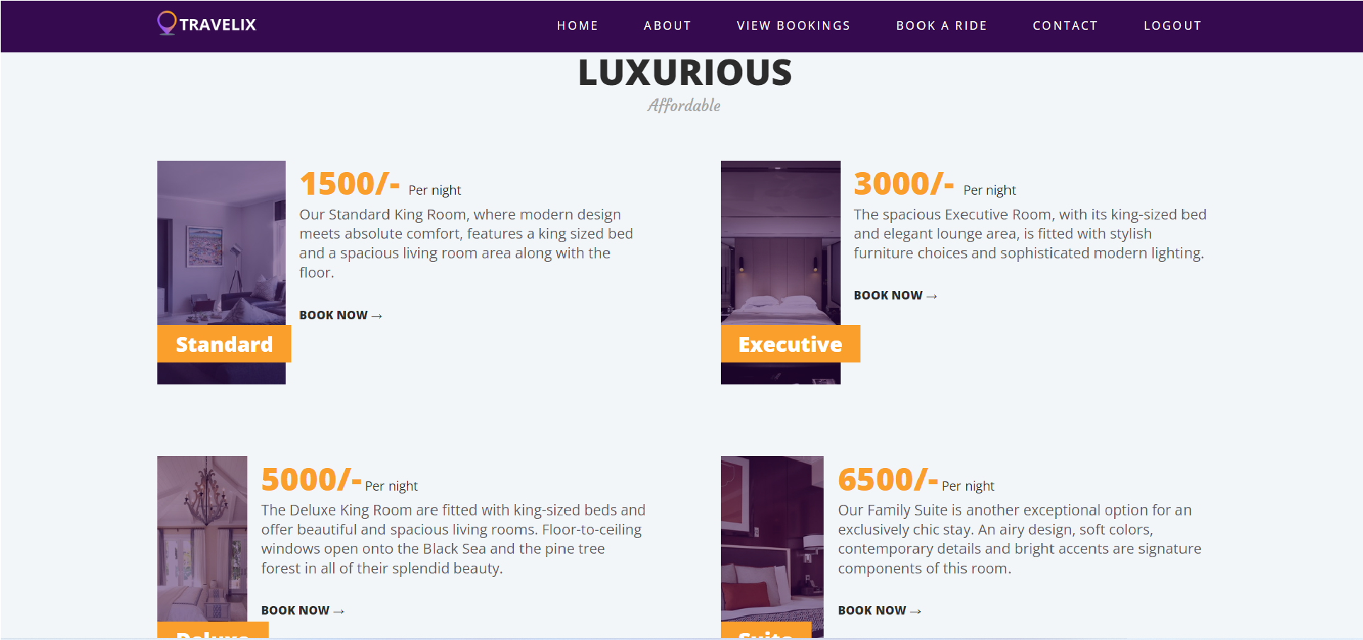
User Interface
Travelix Department of CSE, BMSCE 2021-22
11

Slide 12
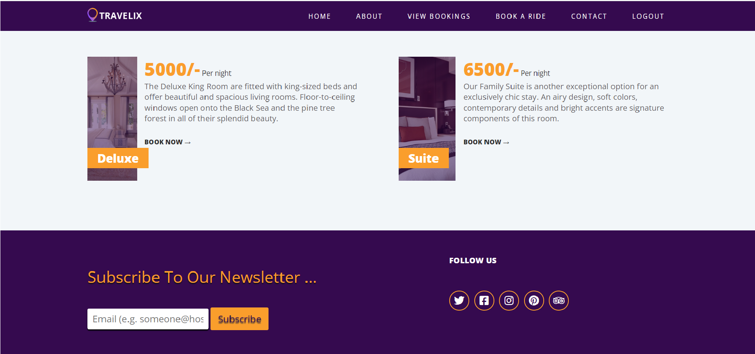
User Interface
Travelix Department of CSE, BMSCE 2021-22
12

Slide 13
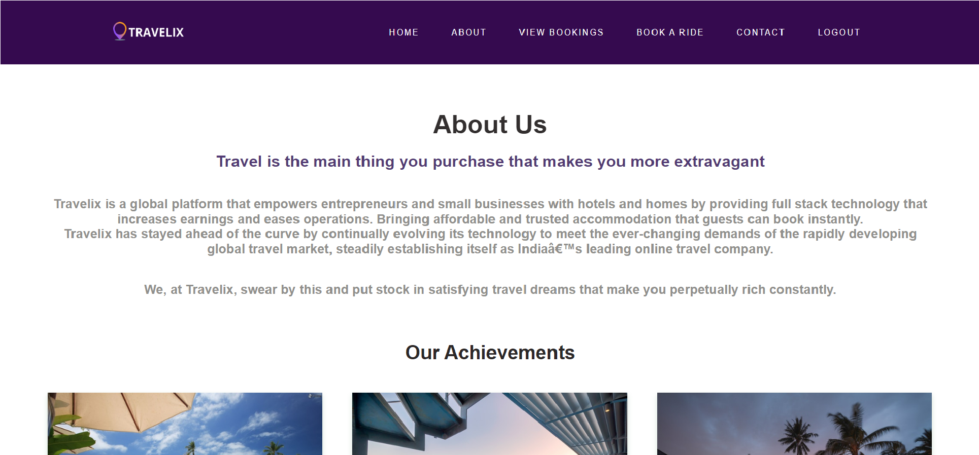
User Interface
About Us
Travelix Department of CSE, BMSCE 2021-22
13

Slide 14
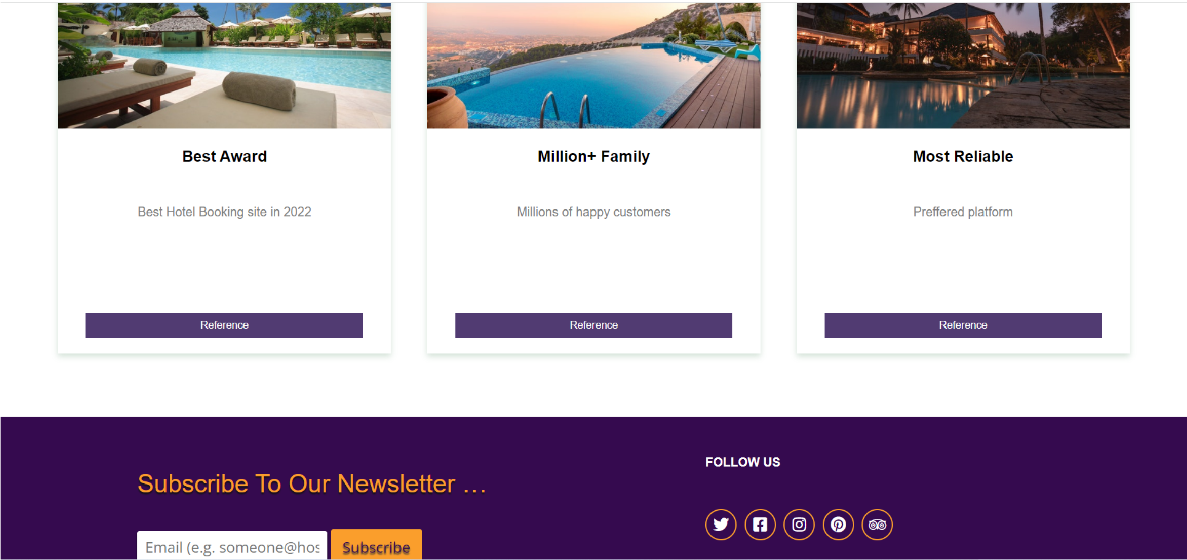
User Interface
Travelix Department of CSE, BMSCE 2021-22
14

Slide 15
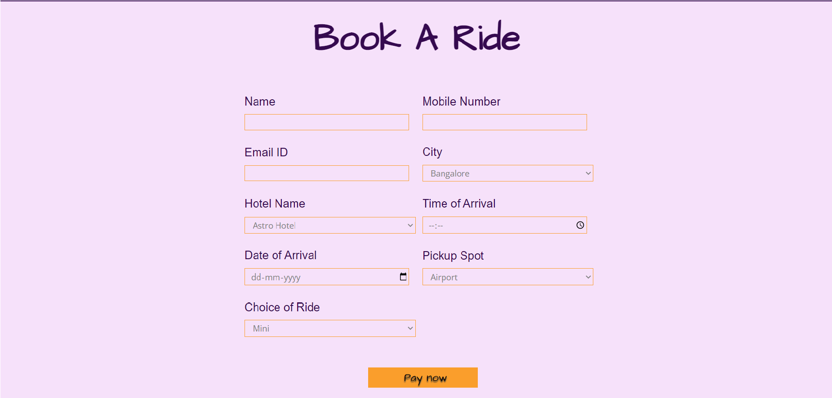
User Interface
Book a Ride
Travelix Department of CSE, BMSCE 2021-22
15

Slide 16
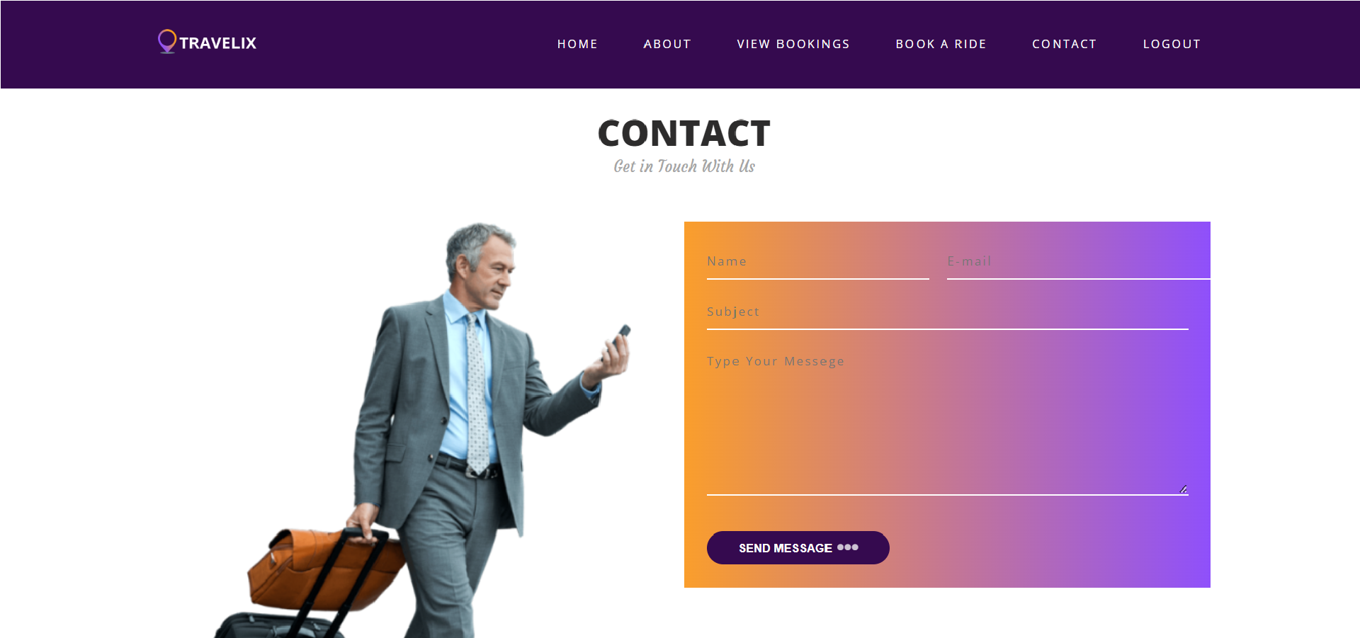
User Interface
Contact Us
Travelix Department of CSE, BMSCE 2021-22
16

Slide 17
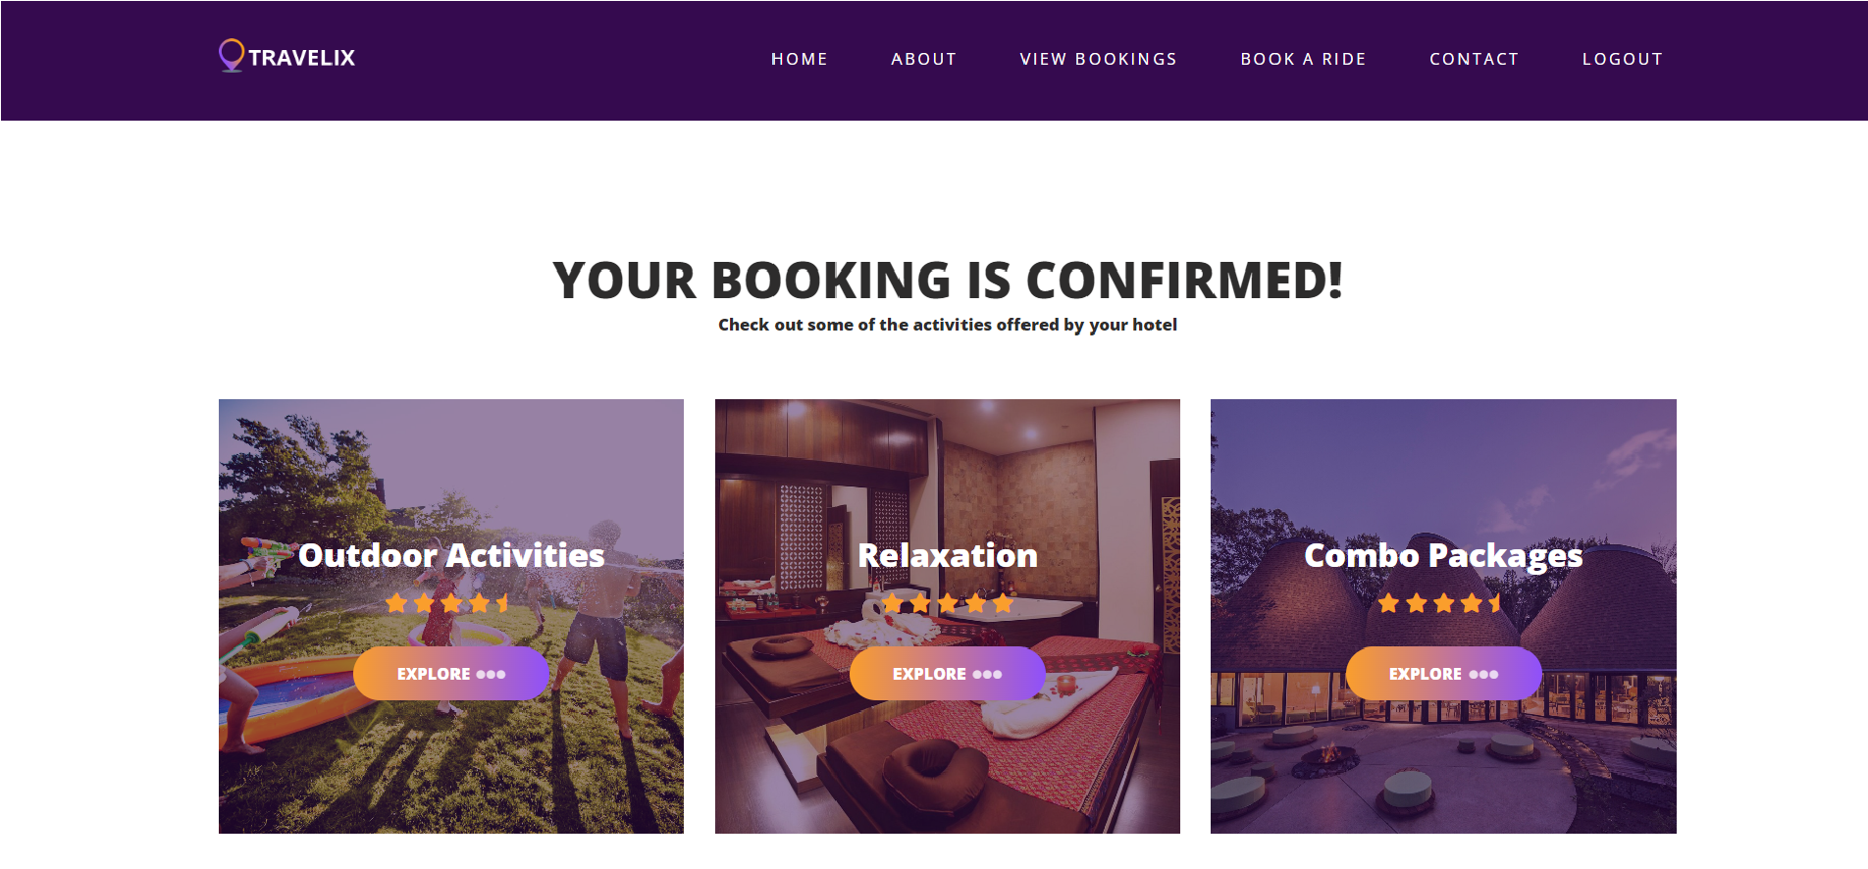
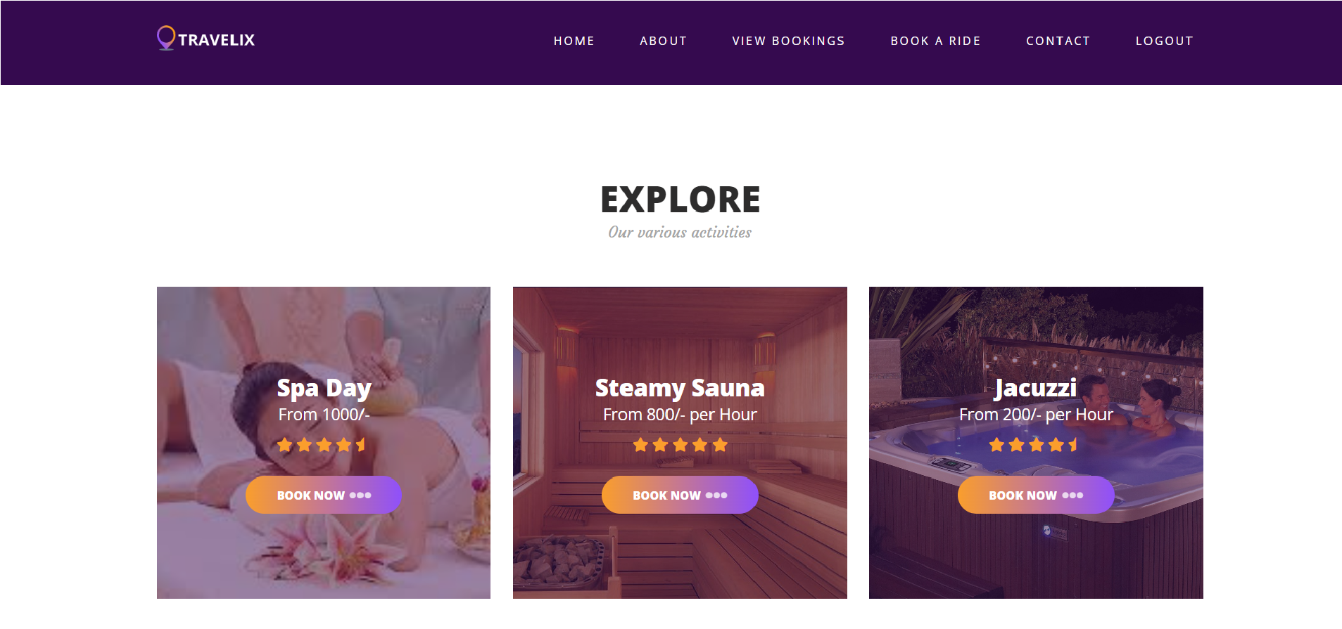
User Interface
Activities
Travelix Department of CSE, BMSCE 2021-22
17

Slide 18
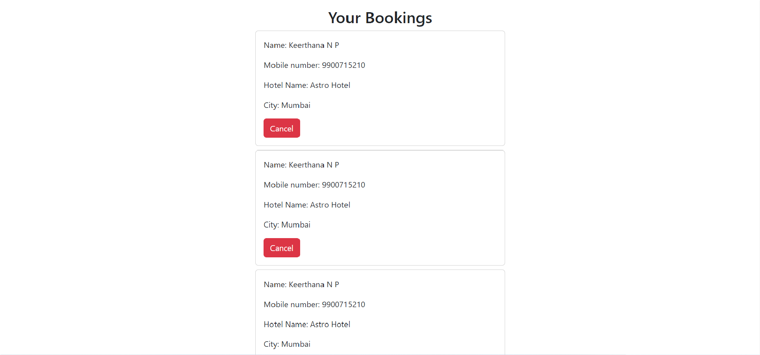
User Interface
Cancel Booking
Travelix Department of CSE, BMSCE 2021-22
18

Slide 19
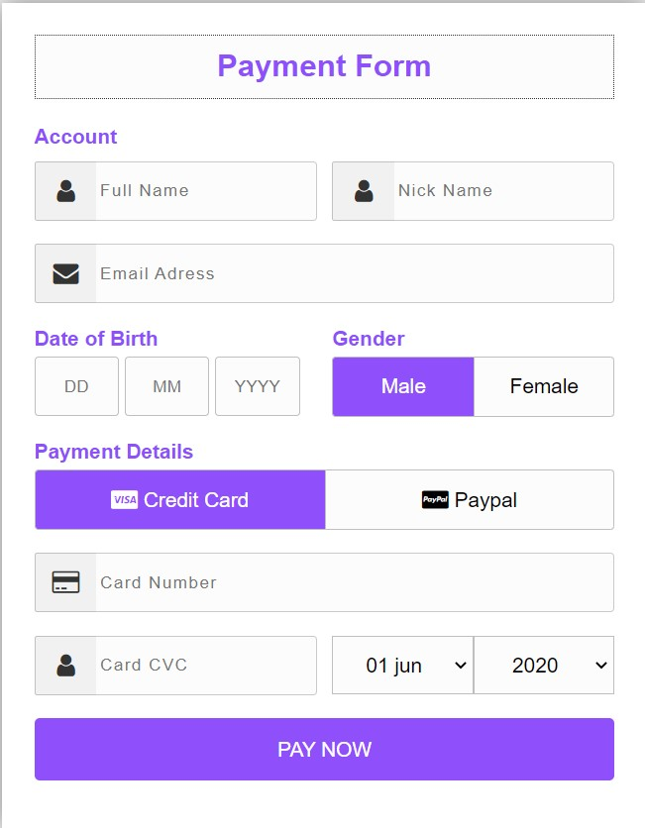
User Interface
Travelix Department of CSE, BMSCE 2021-22
19

Slide 20
THANK YOU
Travelix Department of CSE, BMSCE 2021-22
20

